Slide 1
Project Phase – I (20CS713) – C19 Machine Learning Based Patient Classification In Emergency Department
Team Members :
Y.CHARISHMA REDDY - 111720102177 V.SANDHYA – 111720102165
Mentor : C.Geetha M.E., Ph.D., (Professor)

Slide 2

01
ABSTRACT

Slide 3
The "Machine Learning-Based Patient Classification in Emergency Department" software project is dedicated to urgently improving patient management within healthcare emergency departments (EDs), using cutting-edge machine learning techniques. The system classifies patients based on acuity levels and medical needs by analyzing patient data like vital signs and medical history. Its objectives include streamlining patient triage, optimizing resource allocation, facilitating real-time clinical decision-making, and accumulating data for research. This user-friendly software integrates seamlessly with existing hospital systems, promising substantial enhancements in healthcare outcomes by elevating patient care, reducing ED congestion, and refining resource allocation.

Slide 4
02
System Architecture

Slide 5
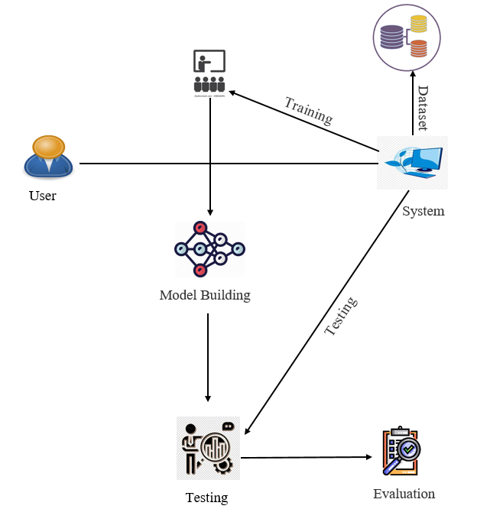

Slide 6
03
LITERATURE SURVEY

Slide 7
1. Paper title : Machine Learning Based Patient Classification In Emergency Department (IEEE 2023)
This study focuses on the systematic categorization of patients in a hospital's Emergency Department (ED) based on the severity of their medical conditions. Leveraging machine learning techniques, the research aims to swiftly identify whether a patient requires immediate clinical intervention. Input data comprises crucial vital signs, including Systolic Blood Pressure (SBP), Diastolic Blood Pressure (DBP), Respiratory Rate (RR), Oxygen saturation (SPO2), Random Blood Sugar (RBS), Temperature, and Pulse Rate (PR). These parameters serve as the foundation for assessing the patient's risk level.
The classification output results in two categories: high-risk or non-risk. Essential machine learning algorithms such as Logistic Regression (LR), Gaussian Naïve Bayes (NB), Support Vector Machine (SVM), K-Nearest Neighbors (KNN), and Decision Trees (DT) are employed to perform this categorization. To evaluate the model's performance, precision, recall, and the F1-score are considered.
Remarkably, the decision tree algorithm yields the highest F1-score, achieving an impressive 77.67% accuracy in classifying risk levels within an imbalanced dataset. This research demonstrates the potential of machine learning to enhance patient triage and prioritize critical cases in a hospital's ED, ultimately leading to more efficient healthcare delivery.

Slide 8
2. Paper title : Artificial Rabbits Optimizer With Machine Learning Based Emergency Department Monitoring and Medical Data Classification at KSA Hospitals (IEEE Access 2023)
Emergency Departments (EDs) situated in key regions of Saudi Arabia experience a substantial influx of patients, primarily attributed to factors like the ongoing pandemic, viral outbreaks, and special events such as Umrah or Hajj, during which pilgrims with severe health issues travel across different areas. Beyond EDs, it becomes imperative to monitor patient transitions from the ED to other sections within the hospital or region to track the potential spread of viral diseases. In this context, advanced deep learning (DL) and machine learning (ML) methodologies have been harnessed to trace and categorize the target demographic into multiple classes.
Motivated by these concerns, this study introduces the Artificial Rabbit Optimization with Machine Learning-based Healthcare Data Classification (AROML-HDC) technique, specifically tailored for EDs. The AROML-HDC method effectively monitors and records patient visitation data, treatment regimens, and length of stay (LOS). Furthermore, it devises an efficient ARO algorithm for optimal feature subset selection. The subsequent step involves the application of the Class-Specific Cost Regulation Extreme Learning Machine (CSCR-ELM) classifier for precise medical data classification. To fine-tune the parameters associated with the CSCR-ELM classifier, the Grasshopper Optimization Algorithm (GOA) is deployed.
The AROML-HDC approach's experimental results are evaluated using the benchmark Cleveland dataset and the Statlog dataset, each comprising 297 and 270 samples, respectively. The simulation outcomes demonstrate the superior performance of the AROML-HDC technique compared to recent methods, achieving a remarkable maximum accuracy rate of 93.22% for the Cleveland dataset and 94.05% for the Statlog dataset.

Slide 9
3. Paper title : Electronic-Medical-Record-Based Identification of Sepsis Patients in Emergency Department: A Machine Learning Perspective (IEEE 2020)
Timely identification of sepsis in patients is of paramount importance for reducing mortality rates and ensuring prompt medical intervention. This research undertakes a comparative analysis of various prominent machine learning (ML) techniques to detect sepsis in emergency department (ED) patients within the first 6 hours of their care. The ML methodologies assessed include Decision Tree, Discriminant Analysis, Logistic Regression, k-Nearest Neighbors (KNN), Ensemble Classification, Support Vector Machine (SVM), and Neural Network (NN). Additionally, we incorporate a novel rule-based system optimized using genetic algorithms, previously developed in a separate study.
This comparative investigation encompasses a dataset comprising 912 sepsis cases and 975 non-sepsis cases, involving patients admitted to the Detroit Medical Center's ED in Michigan, USA. Expert physicians individually adjudicated each case. The Fine Gaussian SVM exhibited the highest sensitivity at 95.8%, albeit with moderate specificity (77.7%) and a positive predictive value (PPV) of 80.1%. The Coarse KNN displayed the highest specificity at 94.5% but with sensitivity at 84.9%. The rule-based system achieved 90.9% sensitivity, 90.9% specificity, and a 90.3% PPV. The NN model outperformed the other ML models and the rule-based system, attaining 92.08% sensitivity, 92.33% specificity, and a 91.78% PPV.

Slide 10
4. Paper title : Hospital Admission Location Prediction via Deep Interpretable Networks for the Year-Round Improvement of Emergency Patient Care (IEEE ComSoc 2021)
This paper introduces a deep learning approach for predicting the destination within a hospital where patients will be admitted following triage in the Emergency Department (ED). This predictive capability is invaluable for proactively arranging hospital bed space to ensure timely patient care and allocation of resources to the appropriate departments, particularly during periods of heightened demand associated with seasonal spikes in infections. The problem is formulated as a multi-class classification task encompassing seven distinct ward types.
Innovatively, we devised a deep learning training strategy that combines curriculum-based learning with a multi-armed bandit approach to optimize the curriculum after initial training. Our results demonstrate successful predictions of the initial hospital admission location, with area-under-receiver-operating-curve (AUROC) values ranging from 0.60 to 0.78 for individual wards and an overall maximum accuracy of 52%, compared to a chance rate of 14% in this seven-class scenario. We also incorporated a 'network saliency' term in the network loss function to elucidate the key features influencing predictions.
In conclusion, this study establishes the feasibility of predicting hospital admission locations for emergency patients based on information gathered during ED triage. Furthermore, it identifies specific diagnostic tests that provide insights into a patient's likely hospital destination. This predictive tool holds significant potential for healthcare institutions, enabling proactive resource planning and bed allocation, ultimately expediting patient care, improving ED patient flow, and enhancing overall care quality.

Slide 11
5. Paper title : Implementation of Classification Algorithm C4.5 in Determining the Emergency Patient in the Maternity Hospital Queue System (ICCoSITE 2023)
According to the epidemiological update detailing the weekly spread of Covid-19 as of February 23, 2021, Indonesia held the unenviable rank of second-highest in the Southeast Asia region for reporting new cases. In response, the Indonesian government initiated a series of measures to curb the virus's transmission, spanning the enforcement of health protocols in public places and the imposition of restrictions on community activities. Health facilities, being part of the essential sector, were permitted to operate at full capacity while adhering to regulated operating hours and more stringent health protocols.
This study is dedicated to the implementation of a patient classification model employing the C4.5 algorithm, designed to identify emergency patients within the maternity hospital queue system. The research methodology follows the Cross-Industry Standard Process for Data Mining (CRISP-DM), and the evaluation of classification data relies on the Confusion Matrix and Receiver Operating Characteristics (ROC).
The C4.5 algorithm's application within the Maternity Hospital Queue System effectively distinguishes between emergency and non-emergency patients, achieving an impressive classification accuracy rate of 97.08%. Additionally, the Area Under the Curve (AUC) value reaches a commendable 0.984 in this study.

Slide 12
References :
[1] M. Shahul and P. K. P, "Machine Learning Based Patient Classification In Emergency Department," 2023 International Conference on Advances in Intelligent Computing and Applications (AICAPS), Kochi, India, 2023, pp. 1-5, doi: 10.1109/AICAPS57044.2023.10074003.
[2] L. A. Alharbi, "Artificial Rabbits Optimizer With Machine Learning Based Emergency Department Monitoring and Medical Data Classification at KSA Hospitals," in IEEE Access, vol. 11, pp. 59133-59141, 2023, doi: 10.1109/ACCESS.2023.3284390.
[3] A. Mohamed, H. Ying and R. Sherwin, "Electronic-Medical-Record-Based Identification of Sepsis Patients in Emergency Department: A Machine Learning Perspective," 2020 International Conference on Contemporary Computing and Applications (IC3A), Lucknow, India, 2020, pp. 336-340, doi: 10.1109/IC3A48958.2020.233670.
[4] R. El-Bouri, D. W. Eyre, P. Watkinson, T. Zhu and D. A. Clifton, "Hospital Admission Location Prediction via Deep Interpretable Networks for the Year-Round Improvement of Emergency Patient Care," in IEEE Journal of Biomedical and Health Informatics, vol. 25, no. 1, pp. 289-300, Jan. 2021, doi: 10.1109/JBHI.2020.2990309.
[5] Y. Septiana, Y. H. Agustin, M. Nashir Mudzakir, A. Mulyani, D. D. Siti Fatimah and I. Tri Julianto, "Implementation of Classification Algorithm C4.5 in Determining the Emergency Patient in the Maternity Hospital Queue System," 2023 International Conference on Computer Science, Information Technology and Engineering (ICCoSITE), Jakarta, Indonesia, 2023, pp. 790-794, doi: 10.1109/ICCoSITE57641.2023.10127842.

Slide 13
04
Technology Stack

Slide 14
Programming Languages : Python
Machine Learning Frameworks and Libraries : TensorFlow, PyTorch
Data Processing and Analysis : Pandas, NumPy, Matplotlib
Web Development : Django
Frontend development : HTML, CSS, JavaScript
Database : MySQL, SQLite
Cloud Services : Amazon Web Services (AWS), Google Cloud Platform (GCP), Docker
Development and Version Control Tools : GitHub
IDE (Integrated Development Environment) : Jupyter Notebook
Testing and Quality Assurance : PyTest
Collaboration and Communication : Microsoft Teams
Deployment : AWS, GCP, or Azure.

Slide 15


